Slide 1
Organizational Requirement

Slide 2


Agenda
A
Introduction
Types
Summary

Slide 3
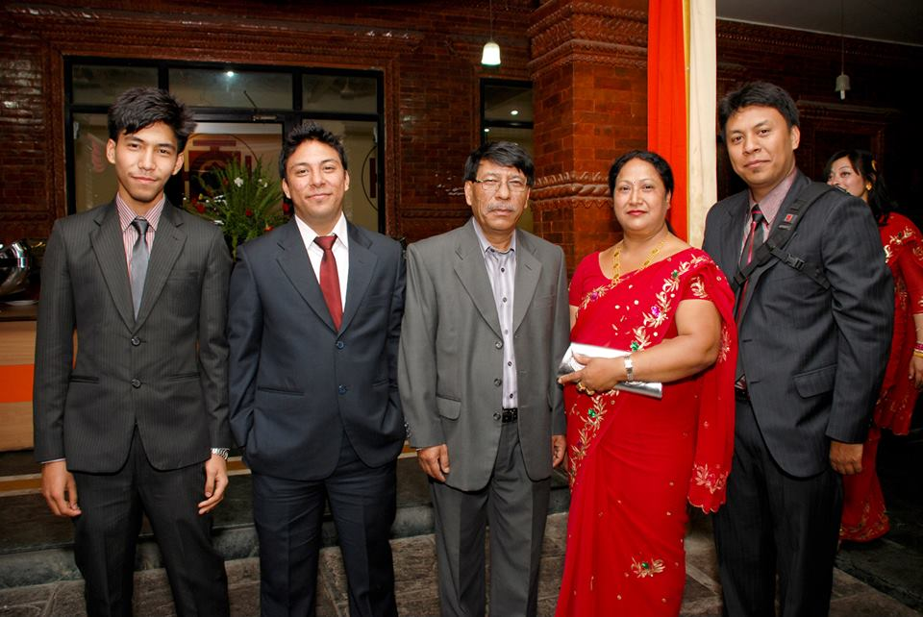
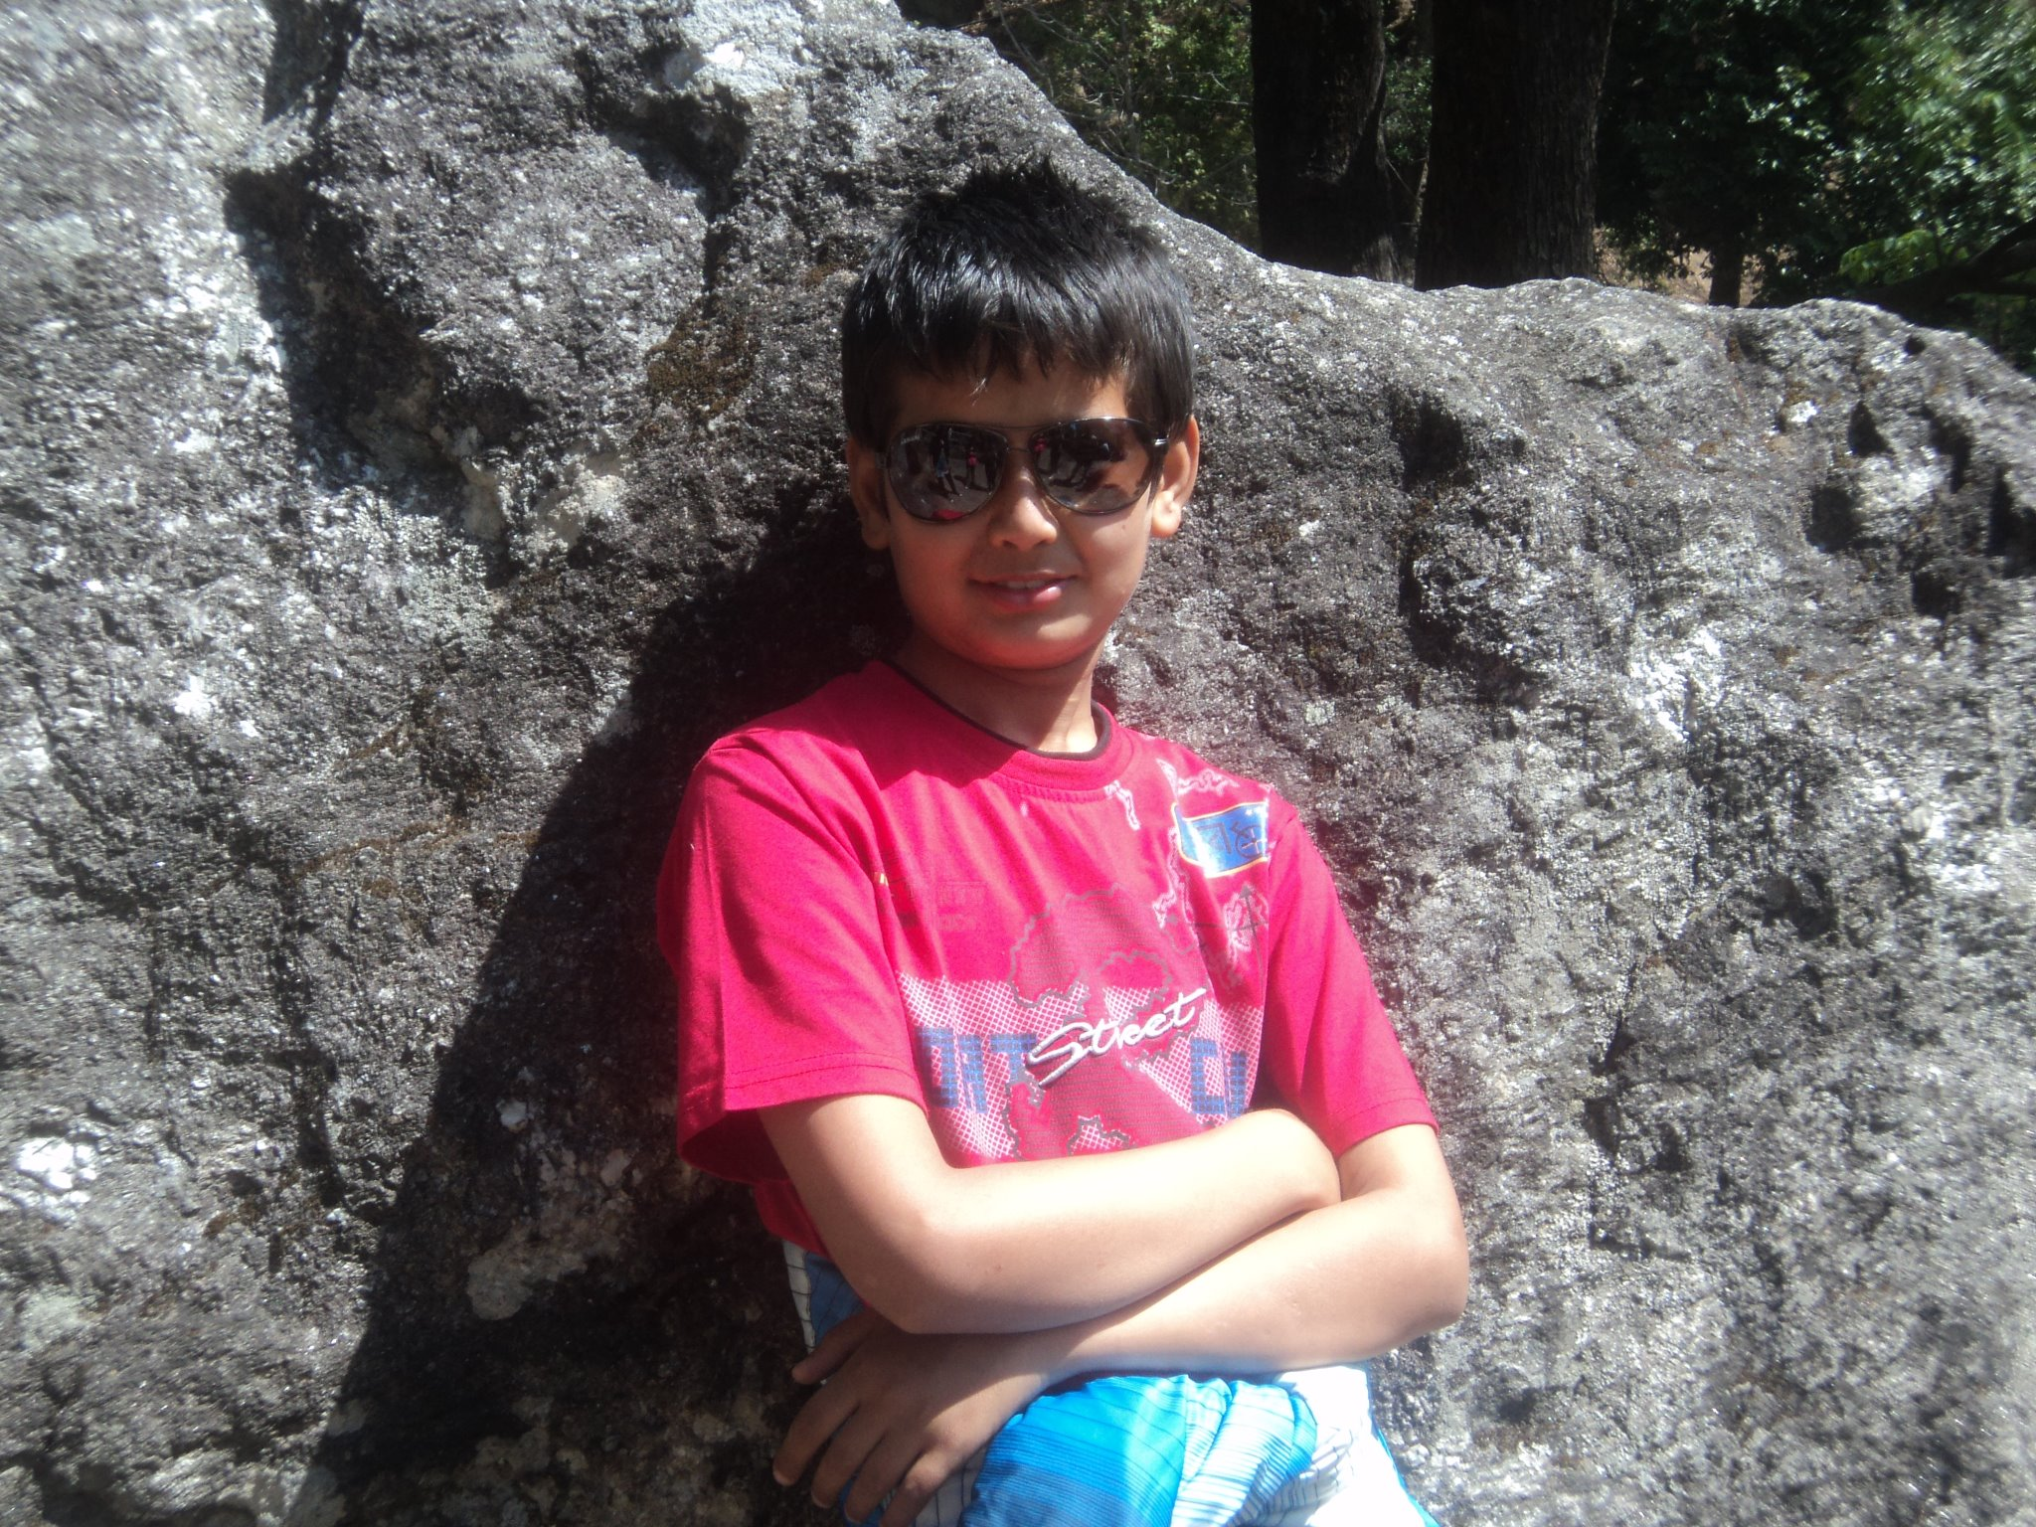
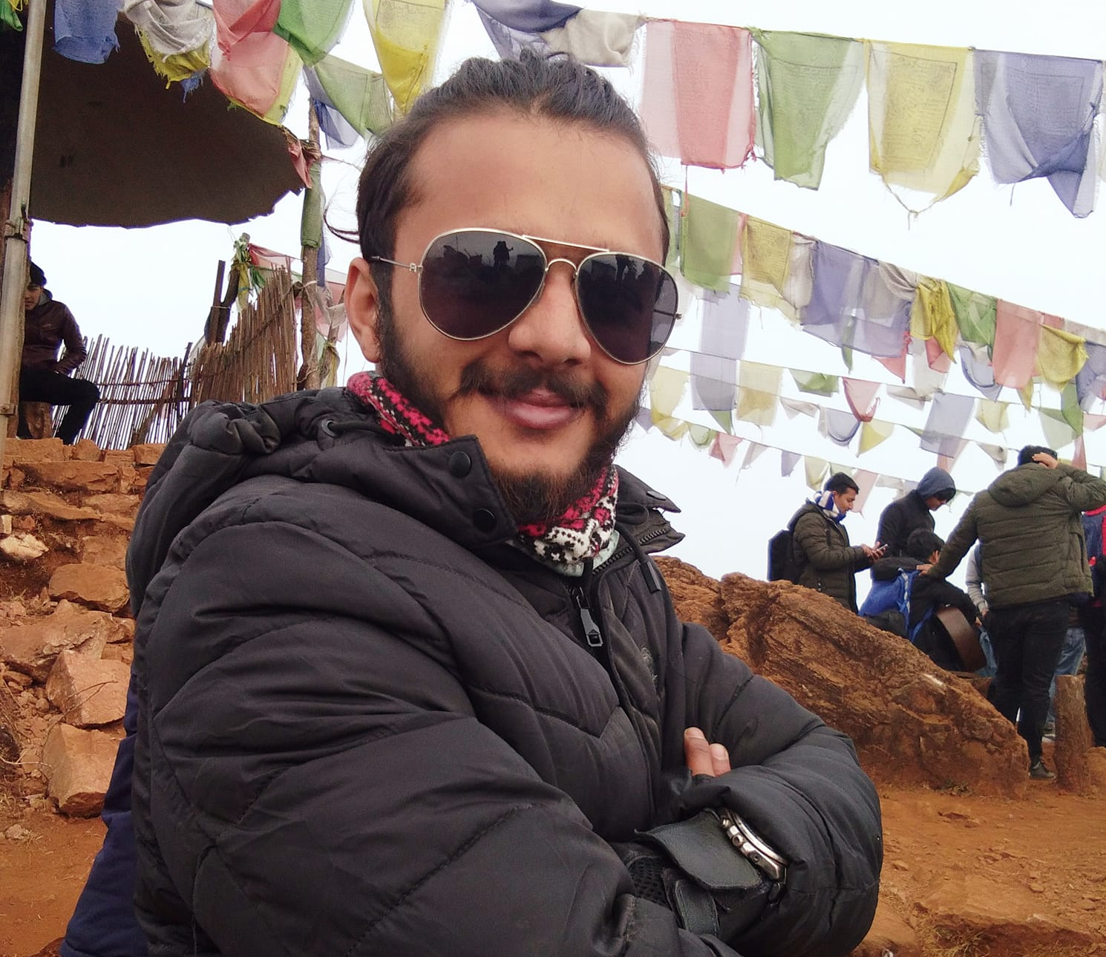
Meet our team
Ayush Tamrakar​
Shishir Acharya​
Prabesh Adhikari​

Slide 4
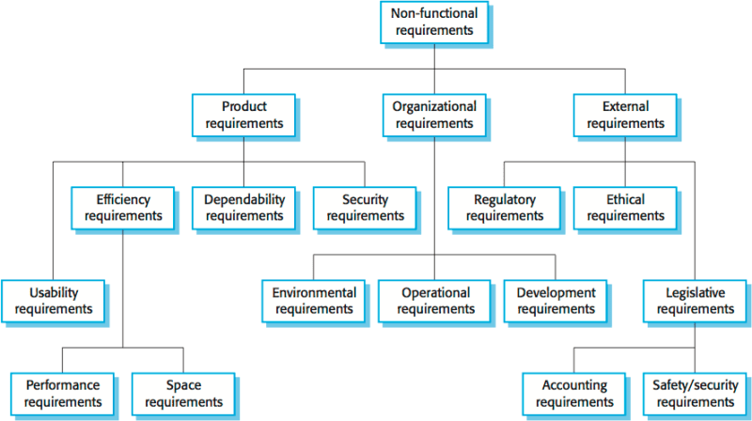

Slide 5
Introduction
Given by the customer
To be fulfilled by software team

Slide 6
Types
T
Environmental Requirement
Operational Requirement
Development Requirement

Slide 7
Environmental Requirements
Workspace

Slide 8
Language Centered Environment
Structure Oriented Environment
Toolkit Environment

Slide 9
Operational Requirement
Operations, Functions and Performance

Slide 10
Mission Profiles
Infrastructure needed
Logistics and Maintenance
Responsible party generating requirements
Environment

Slide 11
Developmental Requirements
Gathering requirements from clients

Slide 12
Feasibility Study
Requirement Gathering
Software Requirement Specification
Software Requirement Validation

Slide 13
Business opportunities are like buses. There's always another one coming.
“
”
Richard Branson

Slide 14
Plan for product launch
Market Entry
Planning
Value
Demand
Unique Selling Point
Competitive?
Marketing
Social Media Campaigns
In depth analysis of competitor
Design
Idea Screening
Emphasizing requirement
Research
Target Market
Budgeting
Launch
Strategy

Slide 15
Summary
Product Requirement
Efficiency Requirement
Reliability Requirement
Portability Requirement
Usability Requirement

Slide 16
Thank you
MBA IT
8th Batch
School of Management

